Slide 1
Risk Management and Threat Modeling
Lesson 2.2
GRC Day 2
Cybersecurity
Lesson 22.2

Slide 2

Learning Objectives
By the end of today’s lesson, you’ll be able to:
1
Identify threat agents, possible attacks, and exploitable vulnerabilities relevant to a given asset.
2
Prioritize risks based on likelihood and impact potential.
3
Choose and justify controls for a given risk.

Slide 3
Today’s lesson will introduce risk management and threat modeling as methods
for identifying, anticipating, budgeting, and planning for when risks occur.
These tools will allow us to:
Enumerate possible risks, threats, and vulnerabilities to a company.
Identify the most likely and most serious risks.
Evaluate the impact the occurrence of a serious risk may have.
Develop strategies for monitoring and mitigating risks.

Slide 4

Threat Modeling and
Risk Management

Slide 5
What’s the difference between a vulnerability, a threat, and a risk?

Slide 6
A vulnerability is an aspect of a business that can be exploited to compromise a system’s CIA.

Slide 7
A threat is an actor that might exploit a vulnerability.

Slide 8
A risk is the possibility of losing something valuable.

Slide 9
Risk Management and Threat Modeling
Risk Analysis | Understanding the risks faced by an organization, which are most severe, and which are most likely.
Risk Management | Using the results of risk analysis to create a plan for preventing likely risks.
Threat Modeling | Determining which attacks an organization is most likely to experience, who is most likely to launch them, and what actions can be taken to prevent them.

Slide 10
What is a business’s primary objective?

Slide 11
A business’s primary objective is to maximise profits.

Slide 12
Risk Management and Threat Modeling
Risk analysis, risk management, and threat modeling directly contribute to business profit.
Risk analysis helps a business understand how much it will need to spend if a given security break happens.
When possible, risks are measured quantitatively in financial figures, which businesses use to prioritize threats.
Threat modeling results are shared upward to the executives who make the major business decisions.

Slide 13

Risk Management and Threat Modeling
These practices directly relate to a business’s pursuit of profit:
Risk analysis is important because it quantifies how much a business needs to spend if a given security breaks happens.
Therefore, the business can plan for setbacks before they occur.
Threat modeling is a key step to risk management because a risk is essentially a price the business pays if the threat happens.
Therefore, it can prioritize the most expensive risks.
Notes:
shutterstock_1165064974

Slide 14

Threat Modeling Methodology: PASTA
PASTA focuses on aligning considerations of business objectives with technical requirements.
P
A
S
T
A
Process for Attack Simulation and Threat Analysis
Notes:
shutterstock_423473107

Slide 15

Threat Modeling Methodology: STRIDE
STRIDE focuses on identifying what
can fail in the system being modeled.
S
T
R
I
D
E
poofing
ampering
epudiation
nformation disclosure
oS (Denial of Service)
levation of privilege
Notes:
shutterstock_1599289462

Slide 16

Threat Modeling Methodology: OWASP
OWASP focuses on identifying possible threats, prioritizing risks, and planning mitigation strategies. It is mainly used with web and desktop applications.
OWASP
pen
eb
pplication
ecurity
roject

Slide 17
OWASP
The OWASP threat modeling process consists of six steps:
01
Determine assessment scope.
02
Identify threat agents.
03
Identify potential attacks.
04
Identify exploitable vulnerabilities.
05
Prioritize identified risks.
06
Mitigate risks.

Slide 18

Step 1: Determine Assessment Scope
List the assets under consideration, determine their value, and define objectives for your threat modeling assessment.
Businesses can’t effectively evaluate everything at once, so they adjust their scope to focus on a specific category of risk.
Scoping begins with asset inventory, the process of identifying and assigning asset value to all of an organization’s assets.
Example
Example
Performing a risk analysis to assess the weakness of a network infrastructure. Within this scope, we are not concerned with application security.
The asset value of a web application could be measured by the revenue or profit it generates.

Slide 19
Step 2: Identify Threat Agents
Determine which attackers would be interested in the relevant assets.
Threat agents include a person or group that can produce a threat, whether or
not that person or group is malicious. Threats agents include:
Advanced persistent threats (APTs)
Script kiddies
Employees opening phishing emails
Incompetent users breaking configurations on company computers

Slide 20
Previously, we’ve addressed unwitting threat agents, like employees opening phishing emails.
Previous lesson
This lesson
Today, we’ll focus on malicious threat agents.

Slide 21
Step 3: Identify Potential Attacks
Identify the attacks each agent is likely to perform.
Different attackers use different modes of attacks. Different attacks mean different risks and considerations.
We can identify a potential attack by considering the threat agent’s motivation, skill level, and amount of funding.
Example
Example
Script kiddies will have different goals than disgruntled employees.
If a client’s web application is taken offline by a DoS attack, the severity of the risk depends on which threat agent is responsible.
Script kiddies might DoS a server simply to cause trouble.
An APT might DoS a server as a smokescreen to steal valuable data.

Slide 22
Step 4: Identify Exploitable Vulnerabilities
Identify the most vulnerable points in a system, how the agent will deliver the attack, and where an attack is most likely to occur.
Once we determine who might attack and what methods they might use, we determine where exactly in the system they will likely direct their attacks and what the risk will be if they do.
Example
If a network has only one database that stores everything, the entire company will lose access to all data if it is compromised.
An attacker seeking to DoS the company's network can exploit this database to achieve their goal.

Slide 23
Threat modeling: Steps 1–4
In this activity, you’ll learn more about GeldCorp’s business operations and assets before applying Steps 1–4 of the OWASP process.
25 minutes

Slide 26

Risk Analysis

Slide 27
In this section, we will focus on risk analysis and walk through the process of prioritizing possibilities of attack.

Slide 28
Risk Management Terms
Risk = threat x vulnerability
Vulnerability is a weakness or misconfiguration in a system.
A threat is any potential danger that is associated with the exploitation
of a vulnerability.
Exposure is an instance of being exposed to losses.
Control, or countermeasure, is put in place to mitigate (reduce) the
potential risk.

Slide 29
Relationship Cybersecurity Ecosystem
Gives rise to
Threat agent
Exploits
Threat
Leads to
Vulnerability
Risk
Asset
Can damage
Exposure
And causes an
Safeguard
Can be counter- measured by a
Source: CISSP All-in-One Exam Guide, Ninth Edition

Slide 30
Risk Analysis
Risk analysis is the process of prioritizing threats identified in Steps 1–4 based on their potential impact and likelihood.
Some threats are more likely than others.
Incidental | Minor | Serious | Major | Catastrophic
Frequent
Occasional
Seldom
Remote
Unlikely
Likelihood
Consequence/Severity
Notes:
shutterstock_1380406934

Slide 31

Script kiddies are likely
to be responsible for most of the attacks an organization experiences simply because there
are so many of them.
For most organizations, organized cyber criminals aren’t a major threat.
They are more relevant
to financial organizations, branches of government,
and military targets.
Notes:
shutterstock_1868833624

Slide 32
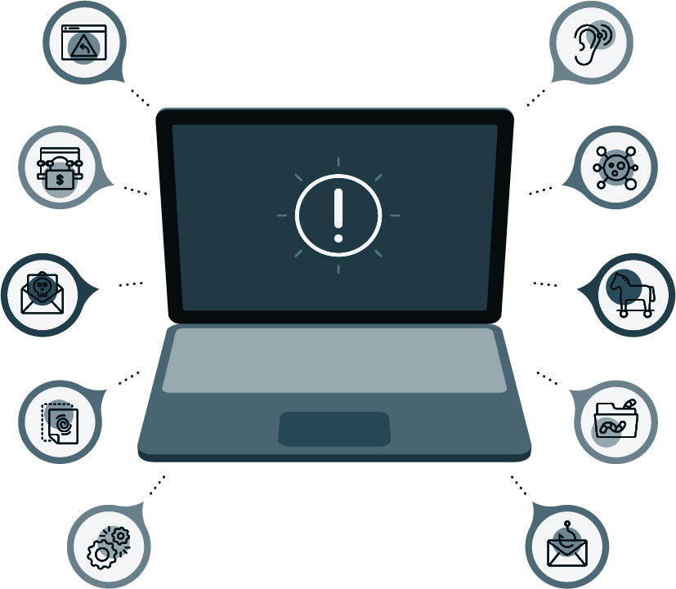
Risk Analysis: Scenario
You’ve identified more than 10 potential attacks that GeldCorp should consider.
All can be mitigated, but each fix costs around $2,500.
GeldCorp’s security department only has $10,000 budgeted for the project.
You must advise which four fixes should be prioritized.
Notes:
shutterstock_1293840505

Slide 33
Risk Analysis: Scenario
Before completing this activity, we’ll learn about:
1
Qualitative vs. quantitative risk analysis.
2
Likelihood, impact, and loss expectancies.
3
Risk factor and heat maps.

Slide 34
Qualitative vs. Quantitative Risk Analysis
Qualitative Analysis
Quantitative Analysis
Evaluates risk based on intangible, unmeasurable factors.
Used when decisions do not require cost-benefit analysis.
Evaluates each risk based on its measured likelihood and impact.
Likelihood: The probability that an event will take place.
Impact: The measure of damage if a risk takes place.

Slide 35


Qualitative vs. Quantitative Risk Analysis
Characteristic | Qualitative | Quantitative
Requires complex functions | No | Yes
Uses cost-benefit analysis | No | Yes
Results in specific values | No | Yes
Requires guesswork | Yes | No
Requires automation | No | Yes
Involves a high volume of information | No | Yes
Objective (based on facts) | No | Yes
Uses opinion | Yes | No
Requires significant time and effort | No | Yes
Offers useful and meaningful results | Yes | Yes

Slide 36
Qualitative Risk Analysis
In some situations, likelihood and impact cannot be accurately measured.
Example 1
Example 2
It’s impossible to calculate
the precise probability that some hacker, somewhere
in the world, will attack your servers within the next year.
It’s impossible to know the precise impact of a breach. The cost of an attack will depend on its length, which
is impossible to determine ahead of time.

Slide 37
Qualitative risk analysis is used when a complex evaluation of cost vs. benefit is unnecessary.

Slide 38


Qualitative Risk Analysis
A company is deciding between an inexpensive VPN service that logs traffic on its servers for internal use and a more expensive service that does not keep any logs.
Example:
A bakery can use qualitative analysis to decide on an inexpensive VPN since it shouldn’t matter much if it is logging non-confidential information.
A government defense or financial organization can use qualitative analysis to decide on a more expensive service since it knows it needs to keep its data confidential.
Notes:
Image sources: shutterstock_683984128 (bakery); shutterstock_1259409754 (bank)

Slide 39
Quantitative Risk Analysis
However, there are circumstances where intuitive analysis is insufficient.
Example 1
Example 2
The security department wants to invest in protecting the organization’s infrastructure.
To secure money from the finance department, they must justify their ask. They will present a quantitative risk analysis to demonstrate that the cost of not investing is much greater than the budget they’re requesting
The executive team must decide whether to migrate to a new cloud provider as part of negotiations with
a potential partner.
To make this decision, they need an accurate assessment of potential losses due to downtime, retraining, risk of data corruption during migration, and other issues.

Slide 40
What’s the main difference between qualitative and quantitative analysis?

Slide 41

Qualitative vs. Quantitative Risk Analysis
Quantitative analysis
focuses on hard numerical data.
Qualitative analysis
focuses on things that cannot be measured through numerical data.

Slide 42
Asset Value and Exposure Factor
To perform quantitative risk analysis, analysts start by calculating how much it will cost if an asset is breached.
Analysts first quantify asset value and exposure factor.
Asset value is how much money an asset is worth in currency.
Exposure factor is how much of an asset will be affected in the breach.
In other words, whether an attack will result in partial and temporary
or complete and permanent destruction of an asset.

Slide 43
Determining Exposure Factor
Exposure factor is always somewhat subjective. We apply a numerical value
for the level of damage an exploited risk would produce.
1.0
Attack would completely eliminate an asset.
0.75
Attack would mostly eliminate an asset.
0.5
Attack would half eliminate an asset.
0.25
Attack would partially eliminate an asset.

Slide 44
A mail server that’s reduced to 0% functionality during a power outage has an exposure factor of what?

Slide 45
Exposure Factor of 1

Slide 46
Loss expectancy is the measure of how much money an organization will lose in the event of a given breach.

Slide 47
Loss Expectancy
Single Loss Expectancy (SLE)
Annual Rate of Occurrence (ARO)
Annual Loss Expectancy (ALE)
Estimated cost of the risk occurring on a given asset.
Estimated number
of times the risk is likely to occur in a given year.
Estimated cost of a risk occurring in a given year.
SLE = AV × EF
AV = Asset value
EF = Exposure factor
ARO = X / 1 years
X = number of occurrences
ALE = SLE × ARO

Slide 48
With an asset value of $10,000 and an exposure factor of 0.5, what is the single loss expectancy?

Slide 49
SLE = AV × EF
10,000 × 0.5 = 5,000

Slide 50
Loss Expectancy
Categories of loss expectancy refer to the degree of a breach’s impact.
Marginal
Notable
Severe
Catastrophic
The organization
has the resources
to respond to the breach immediately, without affecting day-to-day operations or revenue.
The organization
has the resources
to respond to the breach, but may
not be able to do
so immediately.
May experience interruptions to operations.
The organization experiences serious interruptions to operations, and doesn’t have the monetary and/or personnel resources to respond effectively. May have to defer revenue, delay project timelines, reassign employees, or hire consultants to fix the issue.
The organization suffers severe, lasting damage to its reputation and/or infrastructure. The future of the business is threatened by reputational damage, bankruptcy, being found in contempt of federal regulations, or other issues.

Slide 51
In the next demonstration, we’ll see data presented in a spreadsheet and visual formats known as risk matrices and heat maps.

Slide 52
Risk Matrices and Heat Maps
During a risk assessment, we visualize risks to get a holistic view of risks affecting an organization.
A risk matrix is used to compare how many of the risks facing an organization are mild and how many are severe.
A heat map is a visual representation of the probability and likelihood of risks. Organizations
can use heat maps to make strategic decisions about how to protect the company.
 |  | 10 Low | 20 Medium | 30 High | 40 Very High
10 | Low | 1 | 0 | 0 | 0
20 | Medium | 2 | 0 | 0 | 0
30 | High | 2 | 1 | 0 | 1
40 | Very High | 1 | 0 | 0 | 1

Slide 53
The risk spreadsheet

Slide 54
Notes:
Image source: AdobeStock_56885471

Slide 55
Threat modeling Step 5: risk analysis
In this activity, you will complete a spreadsheet and generate
a risk matrix and heat map for GeldCorp.
30 minutes

Slide 58

Mitigating Risks

Slide 59
Now that we’re able to determine which threats are worth our attention and resources, we can craft controls for mitigating risks.

Slide 60
Deciding on Security Controls
Answer the following questions when determining an appropriate control:
Required control type: Should the control be physical, administrative, or technical?
1
2
Required control strength: How strong does the control need to be?
Implementation cost: How much does the control cost compared
to the benefit provided?
3
4
Implementation time: How long will the control take to implement?

Slide 61

Risk Mitigation: Example
LifeNotes is a new medical records company that makes it easy for doctors from different hospitals to share medical records.
When transferring a patient to another hospital or physician, doctors can use the application to share the patient’s medical history, lab results, and medication schedules.
LifeNotes also ensures that doctors can
only see records for their own patients.
However, a client recently reported that
they were able to load records for patients they were not assigned to.
This violates regulatory standards protecting patients’ medical information and it must be resolved immediately.
Notes:
Image source: shutterstock_123779995_medical

Slide 62
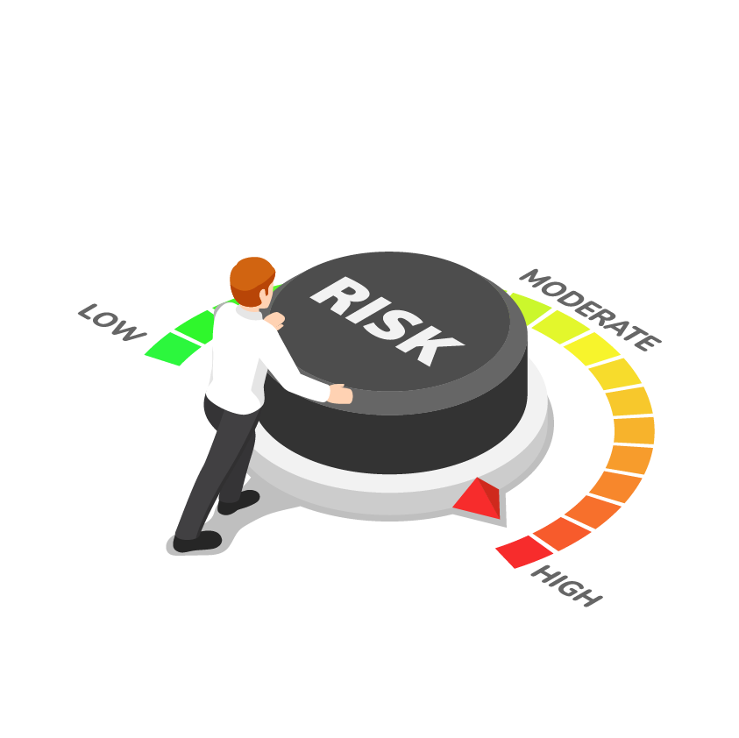
Risk Mitigation: Example
What security controls should
we suggest to LifeNotes?
1
Required control type
2
Required control strength
3
Control decisions
4
Implementation cost
5
Implementation time
Notes:
shutterstock_1290276349

Slide 63
Risk Mitigation: Example
Since this problem must
be fixed immediately, LifeNotes must implement a corrective control. It should also implement protective controls to prevent the issue from recurring. This can be accomplished with administrative to
technical controls.
What security controls should
we suggest to LifeNotes?
1
Required control type
2
Required control strength
3
Control decisions
4
Implementation cost
5
Implementation time
Notes:
shutterstock_1290276349

Slide 64
Risk Mitigation: Example
What security controls should
we suggest to LifeNotes?
The corrective control must completely resolve the issue since the bug means that LifeNotes
is in violation of the law.
The protective control(s) must completely prevent this issue from recurring, for the same reason.
1
Required control type
2
Required control strength
3
Control decisions
4
Implementation cost
5
Implementation time
Notes:
shutterstock_1290276349

Slide 65
Risk Mitigation: Example
The corrective control must completely resolve the issue
since the bug means LifeNotes
is in violation of the law.
Corrective control: Redeploy the older version of the application, which did not have this issue.
Administrative control: Change the way doctors and hospitals communicate data, requiring clients to change their processes and LifeNotes to change how its application works.
Technical control: Implement two-factor authentication, requiring an engineering team to implement a new feature and doctors to learn a new workflow.
What security controls should
we suggest to LifeNotes?
1
Required control type
2
Required control strength
3
Control decisions
4
Implementation cost
5
Implementation time
Notes:
shutterstock_1290276349

Slide 66
Risk Mitigation: Example
LifeNotes can implement the following example controls:
Low cost: Roll back to an older version of the application.
High cost: Change the way doctors and hospitals communicate data, requiring clients to change their processes and LifeNotes to change how its application works.
Medium cost: Implement two-factor authentication, requiring an engineering
team to implement a new feature and doctors to learn
a new workflow.
What security controls should
we suggest to LifeNotes?
1
Required control type
2
Required control strength
3
Control decisions
4
Implementation cost
5
Implementation time
Notes:
shutterstock_1290276349

Slide 67
Risk Mitigation: Example
Rolling back to an older version of the application should take less than a day. Administrative controls would take months to implement. Implementing two-factor authentication would likely take approximately one
quarter (three months).
What security controls should
we suggest to LifeNotes?
1
Required control type
2
Required control strength
3
Control decisions
4
Implementation cost
5
Implementation time
Notes:
shutterstock_1290276349

Slide 68
Threat modeling Step 6: risk mitigation
In this activity, you will conceptualize a risk mitigation plan.
15 minutes

